Slide 1
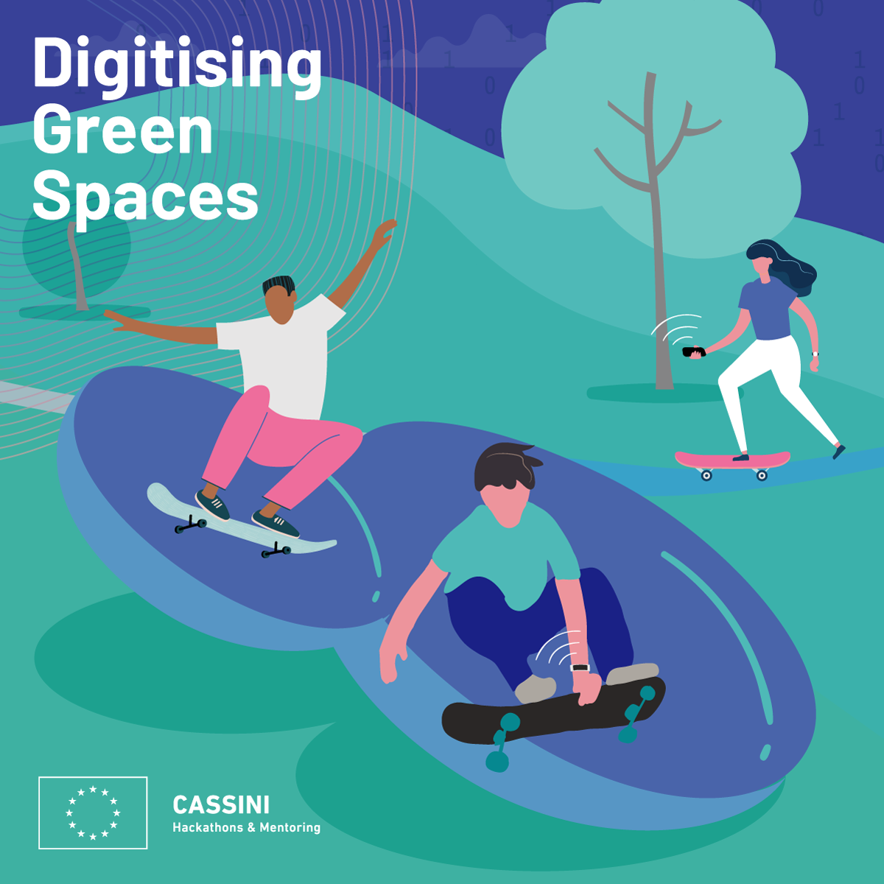
CASSINI HACKATHON GREECE
Go Green
A project prepared by Gen XYZ
20/06/2021

Slide 2



Expected Outcomes
Draw a detailed specification
Evaluate data sources
of citizen needs (i.e. hikers, runners, city breakers) and outline solutions that can be used to tackle them.
that can be used to implement these solutions (Copernicus Hub i.e. Sentinel 2, MODIS etc)
Link the proposal to a business plan
Deliver a Proof-of-Concepts
providing commercial opportunities for furthering application development.
in the form of an interactive web application (supporting testimonials and tips) to validate the scope and content of the proposal.

Slide 3
“A walk in nature walks soul back home”
Ancient Greek Quote

Slide 4
Our Team
EVANTHIA KOTSI
LENA KYROPOULOS
Civil - Transportation Engineer. MSc Student in Geo- informatics.
MSc Student in Qualitative Journalism and New Technologies at ECI European Communication Institute. PTA in Physiotherapy. Poet. Song- writer. Comic cartoonist.
ARIS TRITAS
LAMPROS MOUSELIMIS
MSc in Machine Learning. Data Scientist. CTO of TTROTT.
Business Administration.
Geo-data and Coding Enthusiast.

Slide 5
THE INSPIRATION BEHIND GO GREEN!
Especially after the pandemic of COVID-19, our mission is to motivate people to reconnect with nature, exploring unknown green places with more detailed info about trails routing and special features, and finally enjoy all the benefits that wellbeing (cognitive, physical and psychological balance) offer to them.
Generating EQO-Q intelligence

Slide 6


Routing the user to the best location
According to the received info the user can plan, better,
save time, enjoy the moment
health matters : 1) protection ej UV / skin protection
: 2) Prognosis ej Air pollution / respirations
issue, another destination choice of green place
Feedback solicitation after the hiking experience
Specification of a typical user interaction with the app

Slide 7
12,24 billion market
According to our research in “Wonder” and in “Ibis” we realized that the specific customer behaviour of this market will be increased the next years with a very important growth rate. To conclude, there are over 118.26 million people who hike globally and the global market size for hiking is $12.24 billion.
https://askwonder.com/research/globally-people-practice-hiking-global-market-size-sport-ydayybulj

Slide 8
Business opportunities
ECO-RESPONSIBLE RETAILERS
NON-INVASIVE AND PRIVACY-PRESERVING BUSINESS LISTINGS
MATCH-MAKING BETWEEN CITIZENS AND COACHES AND/OR PHYSIOLOGISTS
Acting to preserve green space. Creteria:
- usage of recyclable materials,
- bicycle parking
- EV charging stations
- Magnetic Vehicle Charging.
By putting them on the map, we believe that citizens will notice and search for these locations, thus providing tangible business value that we can monetize as well. ry is the closest planet to the Sun and the smallest one in the Solar System—it’s only a bit larger than our Moon
or selected partners and timely user recommendations based on geolocation (how about a smoothie after your long jog?)

Slide 9
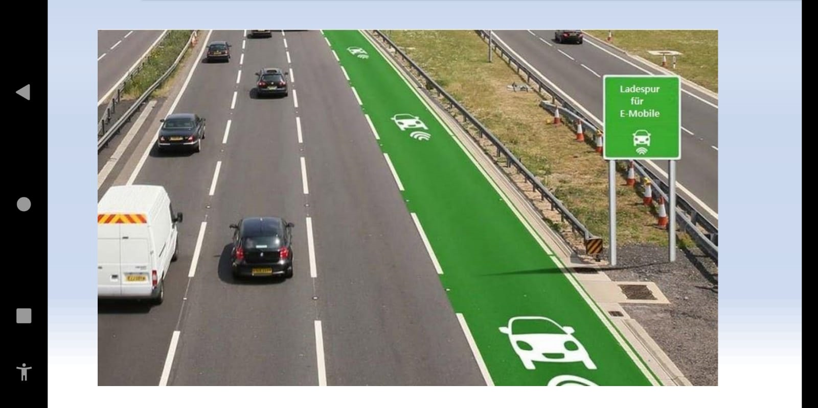


EQO-Q intelligence

Slide 10
.
Commercial part 1
We build nature lovers and explorer’s community with
the commercial part, it would be very useful for the users to have the whole details related to the routing, nice spots, water areas, accomodation, hotels, hostels, med-care, special life experience, even their eco-equipment, that they might are planning to have. The purpose has also a social impact because it reflects on the the specific community of the trails and hiking lovers and city breakers globally. We have chosen Greece and especially Athens about Its unique geomorphological environment. We have on our mind to extend this app also for the Greek islands.
This is the subtitle that makes it comprehensible

Slide 11

Core customer audiences
INDIVIDUAL INTERESTS
GENDER
10%
50%
30%
50%
50%
10%

Slide 12

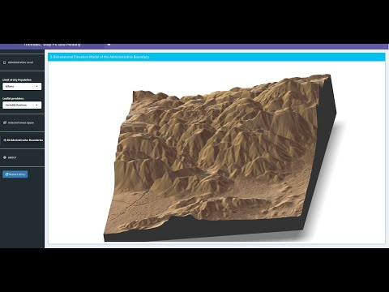
Desktop software

Slide 13
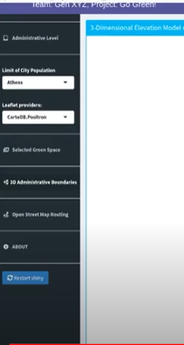
Mobile web

